Slide 1
“Code Troopers” Sprint 2 Stakeholder Update
February 25th, 2022

Slide 2

Progression of Geopop Browser Concept
State machine defining specific actions users may undertake
Hand-Sketched web page facades
Concept solidification

Slide 3

Introducing fully furnished Geopop Browser Github
User Stories
Branches/Releases
Issues utilized

Slide 4

ZUBE.IO
Github Integration
Kanban Board
Specified Sprint Breakdown

Slide 5

Full Use Case Diagram

Slide 6









Full Use Case Defined
Save Reports - Saving reports enables us to refer to previously generated reports, giving us the opportunity to reference where data extracted from Geopop originated from.
Send Help Requests - Sending help requests enables users to petition administrators to aid users encountering a predicament on the system.
Core Function
Additional Function
Administrative Function
Login and Authenticate user - Logging in/registering gives the user access to additional quality of life features, such as, ability to save previously generated reports, ability to personalize settings, and ability to send help requests.
Personalize Account - Personalizing accounts enables users to save setting preferences from previous uses of Geopop.
Generate Reports - Generating reports, allows the user to retrieve information from the database based on user search criterion.
Manage Users - Managing users allows administrators to create or delete accounts as various needs arise, as well as keep track of current users.
Report System Analytics - Reporting system analytics of the website allows administrators to gain further insight and data that can be used to create a better user experience for visitors.
Search Criteria - Searching in the database, requires a user to enter the specifications of their desired information. These include: Geographic region, country, district, city, language.
Prepare Database - Preparing the database enables users to access valid and up-to-date information.
Respond to User Requests - Responding to user help requests allows administrators to provide assistance to users that are having difficulty navigating through the websites' features/functionalities, reducing any unforeseen UI friction with users.

Slide 7
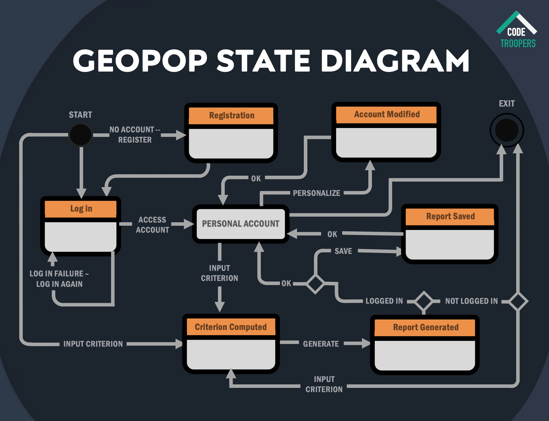

Slide 8

Second Release Additional Content
Meetings log for Stakeholders
Updated Meet the team

Slide 9


Slides prepared by Code Troopers
Add your
Software Engineers at Kamino Softworks who work to change the world and improve the lives of people around the globe. Graduates from Roehampton in 2023 with a degrees in Computer Science. Love to work improving the future with a diverse and dedicated staff.
Code Troopers make no claim to ownership of Media images in this powerpoint. Images taken from Google.

